Slide 1

Medicinal Plant Leaves Detection Project Guide:Ms. Sapna Juneja
Team Members:
Harsh Agrahari (Computer Science) 2000290120069
Mohammad Ausaf (Computer Science) 2000290120096
Rahul Yadav (Computer Science) 2000290120123

Slide 2
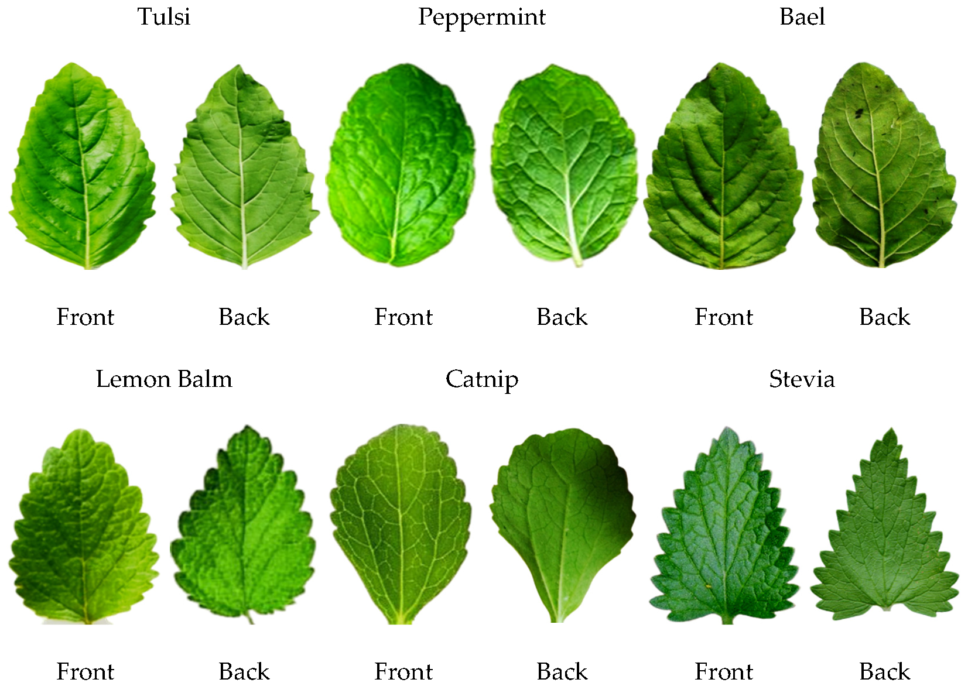
Project Abstract
Medicinal plants are the source of raw herbal medicines. They are less costly and appear to produce less undesirable side effects than modern medicines. Identifying such valuable plants often requires an expert or a manual. Therefore, there is a need to automate processes to retrieve information more quickly. Computer vision-based image processing is one of emerging techniques to computerize such tasks by emulating the human visual system. The aim of the project is to take raw images of the leaves of plants (provided by the user), upon which it identifies whether the plant is one of the 40 medicinal leaves in the chosen dataset of medicinal herbs, if yes, then provide the user with any relevant information relating to the use case and procedure to use them (if any)

Slide 3
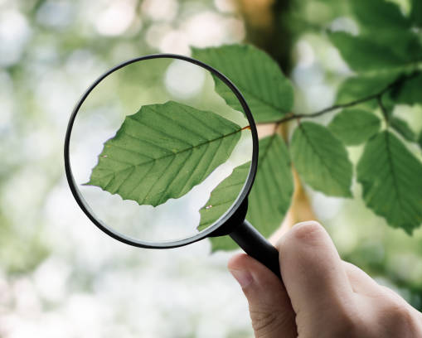
Problem Statement:
The main issue with the identification of the medicinal plants are the lack of knowledge and resources, to identify these leaves (by extension, the plants) one either needs an expert or a manual/guide.
Making matters worse, the very availability of the resources is scarce, hence there is a need to automate the identification/detection procedure.

Slide 4
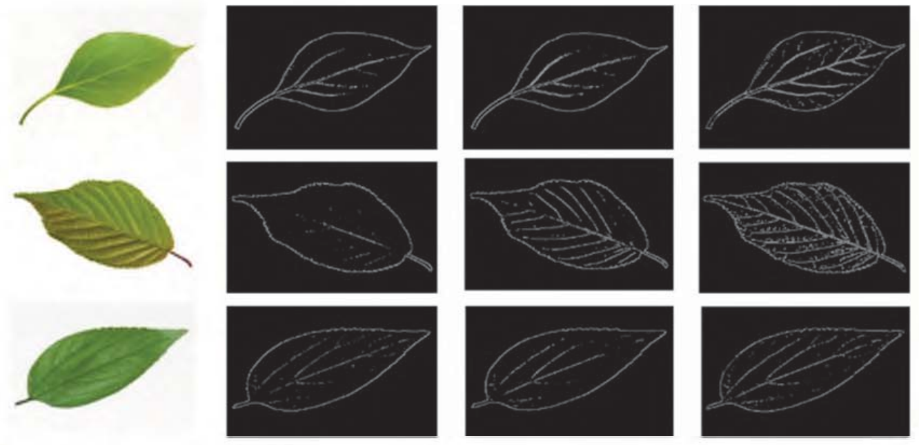
Methods and Algorithms Proposed:
The proposed method is divided into two Stages,
1) Stage 1 : dealing with edge detection of the medicinal leaf,
2)Stage 2 : dealing with classification of the processed image.
Stage 1: Image Edge Detection

Slide 5
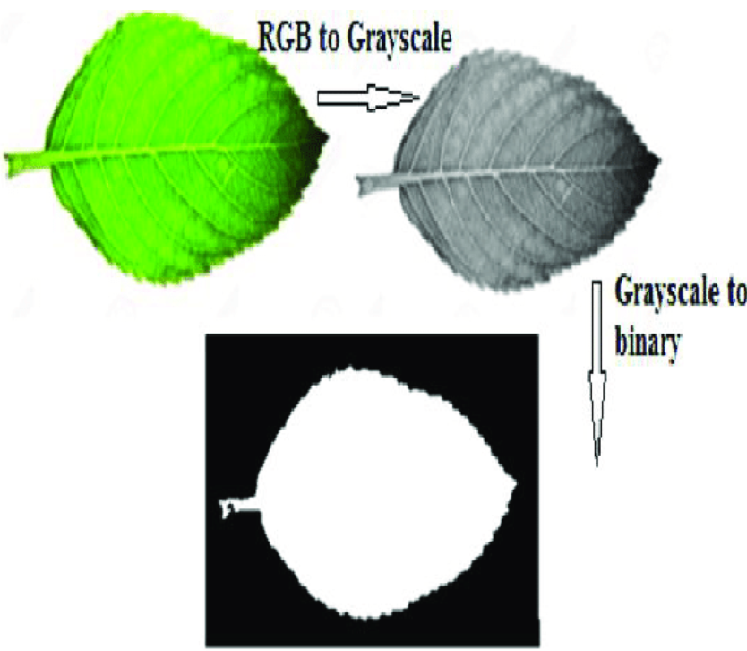
Stage 1:
The given raw image is processed to determine length, breadth, and dimensions of the leaf.
1. The raw input image is taken.
2. The input image is measured for dimensions, that is, for its length and breadth.
3. The image is processed through edge-based detection, giving an edge image outline as an output.
4. The edge outline then undergoes through a Image identification process.

Slide 6
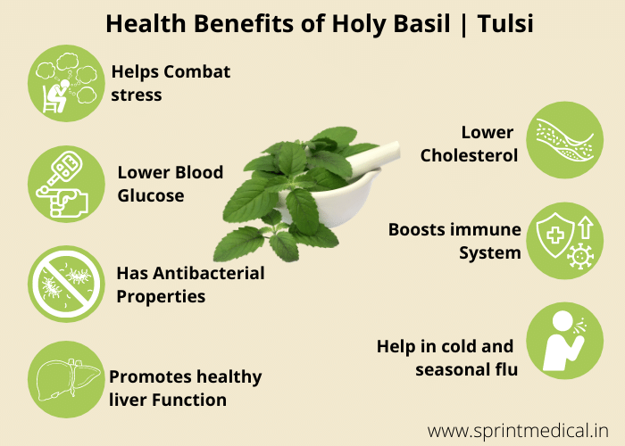
Stage 2:
1) The input raw image will be preprocessed to improve the image clarity.
2)Then, the preprocessed image is processed for feature extraction, there are mainly 3 features[2], namely,
a) Color
b) Shape
c) Measurement
3) The selected feature is then extracted, based upon which we provide the feature as an input to a Machine Learning Classification Model.
4) The Machine Learning model classifies the image in one of the forty species (if applicable).
5) Based on the prediction, the relevant information about the use case and usage instruction is provided to the user.
For Instance: Tulsi Leaves and its uses

Slide 7
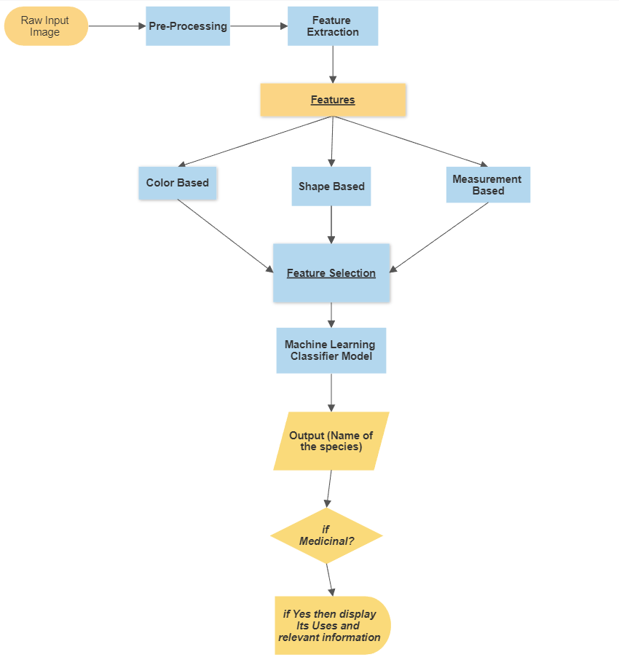
Flowchart of the proposed algorithm

Slide 8
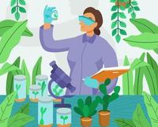
Conclusion:
The Project classifies the medicinal plant leaves, eliminates any human or manual need to identify and thus use Indigenous medicine.
The project also additionally, intends to educate and provide usage instructions for different medicinal herbs, thus, acting as a repository for herbal medicine
This will also help the general population in their day-to-day life to use herbal recipes not just limited to “medicine” rather as a supplement to maybe complement any (if any) disease.
This automatic classification system will help to identify the medicinal plants without getting any human support in various enterprise sectors such as botanists, taxonomists, Ayurveda manufacturing companies, and Ayurveda practitioners.

Slide 9
References :
Putri, Yuanita A., Esmeralda C. Djamal, and Ridwan Ilyas. "Identification of medicinal plant leaves using convolutional neural network." Journal of Physics: Conference Series. Vol. 1845. No. 1. IOP Publishing, 2021.
Manoharan, J. Samuel. "Flawless Detection of Herbal Plant Leaf by Machine Learning Classifier Through Two Stage Authentication Procedure." Journal of Artificial Intelligence and Capsule Networks 3.2 (2021): 125-139.

Slide 10
Tools/Technology/Software/Language Used
Tools/Software
Anaconda software
Jupyter Notebook
Spyder(Anaconda)IDE
GitHub
Visual Studio Code
Websites Referred
GeeksForGeeks.org
towardsdatascience.com
Python Programming Language

Slide 11
Thank You !

